Slide 1



Slide 2
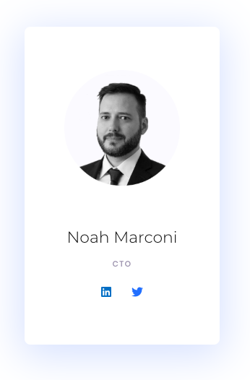
Who am I
12+ year research and software development background with companies such as Vision Critical, LoyaltyOne, Blockable, and Tag Innovation.
Co-designed and developed George Brown College’s Blockchain Development Program. The first of its kind in Canada.
Numerous blockchain pilots and mainnet deployments.
Speaker at industry events, including Deloitte’s CryptoCamp & Airline Information Events.

Slide 3

Four strategies
Data Fields
Lock in what you know
Toggle what you don’t
Start Over
Deploy new contract
Migrate data over
Keep Data, New Address
Keep data contract
Create new logic contract
Interact with data contract from logic contract
Keep Data & Address
Keep data contract
Keep contract address
Delegate calls to new logic contract

Slide 4

Data Fields
Vary your variables

Slide 5

Scenario
Crowdsale contract commissioned
Requires audit ASAP
Client’s multisig address is…unknown

Slide 6
/*----------- Global Address Variables -----------*/
// Recipient of the ETH funds collected.
address public multiSig;
bool public multiSigSet = false;
/*----------- Modifiers -----------*/
/**
*
* @dev Ensures multisig beneficiary address is set.
*
*/
modifier multiSigIsSet() {
require(multiSigSet);
_;
}

Slide 7
/*----------- Owner: Variable Setters -----------*/
/**
* @dev Allows owner to set the multiSig (i.e. beneficiary) address.
* To maintain trustlessness, the address can only be set one time.
* @param _multiSig The multiSig address to receive sale proceeds.
*/
function setMultiSig(address _multiSig) public onlyOwner {
require(!multiSigSet);
require(_multiSig != address(0));
require(_multiSig != address(this));
multiSigSet = true;
multiSig = _multiSig;
}

Slide 8
/*----------- Internal Methods -----------*/
/**
* @dev Forwards funds collected to secure multiSig wallet.
*/
function forwardFunds() internal multiSigIsSet {
multiSig.transfer(msg.value);
}

Slide 9
Scenario
Token needs to be “issued” yesterday
Might be vesting
Vesting terms TBD

Slide 10
interface ILocking {
function canTransfer(address sender, uint256 value)
external
returns (bool);
}
/*---------- Globals ----------*/
// (GMT) Thursday, July 15, 2021 0:00:00.
uint256 public constant lockEnd = 1626307200;
// Locking logic contract. ILocking private locking;
// Disable locking logic update flag. bool public canUpdateLockingLogic = true;

Slide 11
/*---------- Locking Logic ----------*/
function updateLockingContract(ILocking newLocking)
public
onlyMinter
{
require(
canUpdateLockingLogic,
"Locking contract updates are disabled.”
);
locking = newLocking;
}
function disableLockingLogicUpdate()
public
onlyMinter
{
canUpdateLockingLogic = false;
}

Slide 12
/*---------- Transfer overrides ----------*/
function transfer(address to, uint256 value)
public
returns (bool)
{
// solium-disable-next-line security/no-block-members
if(block.timestamp < lockEnd && locked[msg.sender]) {
require(
locking.canTransfer(msg.sender, value),
"Invalid transfer. Funds still locked."
);
}
return super.transfer(to, value);
}

Slide 13
Start Over
Scorched earth: new contract, new address.

Slide 14
Scenario
Launched a token
Errors :(

Slide 15
Scenario
Launched a token
Errors :(
We were prepared :)

Slide 16
interface MigrateContract {
function migrateData(address account, uint256 amount) external;
}

Slide 17
/*---------- Types ----------*/
enum Stage { Active, Stopped, Migrating }
/*---------- Globals ----------*/
mapping (address => uint256) public _balances;
Stage public stage;
MigrateContract private _newContract;
/*---------- Modifiers ----------*/
modifier whenLive() {
require(
stage == Stage.Active,
"Function not permitted when not Status.Active"
);
_;
}

Slide 18
/*---------- Owner Methods ----------*/ function retireContract()
public
whenLive
onlyOwner
{
stage = Stage.Stopped;
}
function initMigrate(MigrateContract newContract)
public
onlyOwner
{
require(
stage == Stage.Stopped,
"Stage must be set to Stopped before initializing migration."
);
stage = Stage.Migrating;
_newContract = newContract;
}

Slide 19
function migrateData(address account)
public
{
require(
stage == Stage.Migrating,
"Stage must be set to Migrating before migrating data."
);
uint256 amountToMove = _balances[account];
delete _balances[account];
_newContract.migrateData(account, amountToMove);
}

Slide 20
Scenario
We don’t know what we don’t know
Elegant upgrade is required
Consensys Curated: https://consensys.github.io/smart-contract-best-practices/known_attacks/
Dasp top 10: https://dasp.co/
SCW Registry: https://smartcontractsecurity.github.io/SWC-registry/

Slide 21
call vs delegatecall
“call - Execute code of another contract
delegatecall - Execute code of another contract, but with the state(storage) of the calling contract.”
Source: https://zupzup.org/smart-contract-interaction/

Slide 22
Locking Example external CALL
Main Contract
CALL: canTransfer
Logic Contract
returns (bool)
Migrate Example external CALL
Old Contract
New Contract
CALL: migrateData
Record migrated data

Slide 23
Caller Callee
Separate Data and Logic

Slide 24
Caller Callee
Callee
CALL: readSomething
Caller V1
returns (bytes memory)

Slide 25
Caller Callee
Callee
CALL: writeSomething
Caller V1
returns (bool)
Records data

Slide 26
Caller Callee
Callee
Caller V1
CALL: readSomething
returns (bytes memory)
Caller V2

Slide 27
Caller Callee
Callee
Caller V1
Caller V2
CALL: readSomething
returns (bytes memory)
Caller V3

Slide 28
interface Callee {
function storeBytes(bytes32 key, bytes calldata value) external;
function getBytes(bytes32 key) external returns(bytes memory);
}
contract Caller { Callee public _callee;
constructor(Callee callee) public {
_callee = callee;
}
function storeBytes(bytes32 key, bytes memory value) public {
_callee.storeBytes(key, value);
}
function getBytes(bytes32 key) external returns(bytes memory) {
return _callee.getBytes(key);
}
}

Slide 29
Proxy
No change in address.

Slide 30
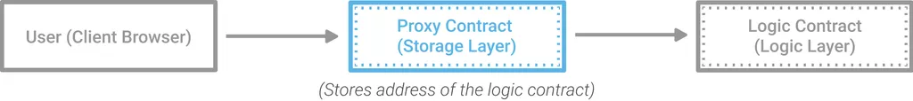
Proxy Pattern
Source: https://blog.zeppelinos.org/proxy-patterns/

Slide 31
address _logicContract;
function implementation() private view returns(address){
return _logicContract;
}
function setLogicContract(address logicContract) public onlyOwner {
_logicContract = logicContract;
}
function () external payable {
address _impl = implementation();
require(_impl != address(0), "Logic contract cannot be address(0)");
assembly {
let ptr := mload(0x40)
calldatacopy(ptr, 0, calldatasize)
let result := delegatecall(gas, _impl, ptr, calldatasize, 0, 0)
let size := returndatasize
returndatacopy(ptr, 0, size) switch result
case 0 { revert(ptr, size) }
default { return(ptr, size) }
}
}

Slide 32

Storage Layout Matters
Logic contract writes to proxy contract and can accidentally overwrite its own location.

Slide 33
Trustlessness went out the window
Whoever can upgrade can introduce malicious code.

Slide 34

Github Repo: https://github.com/NoahMarconi/upgradeStrategies
CAUTION:
Examples meant to communicate concepts
and are not appropriate for production use.

Slide 35

Thank You for your time today
Thank You for your time today
\\\\\\\\\
Morgan Kelly
647.402.1640
morgan@taginnovation.io
Noah Marconi
647.669.5538
noah@taginnovation.io

